Slide 2
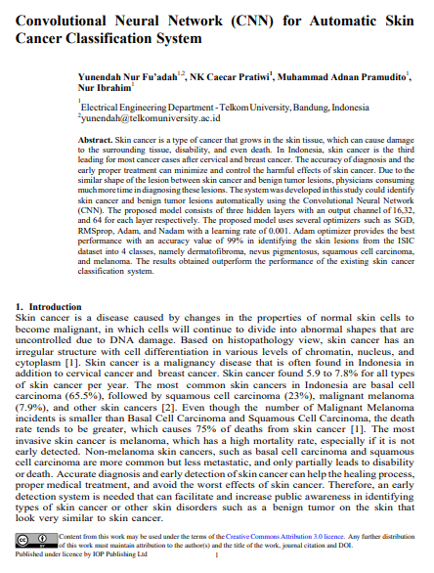
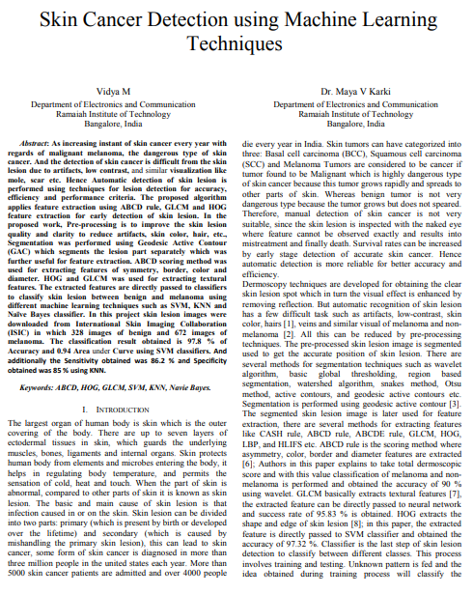
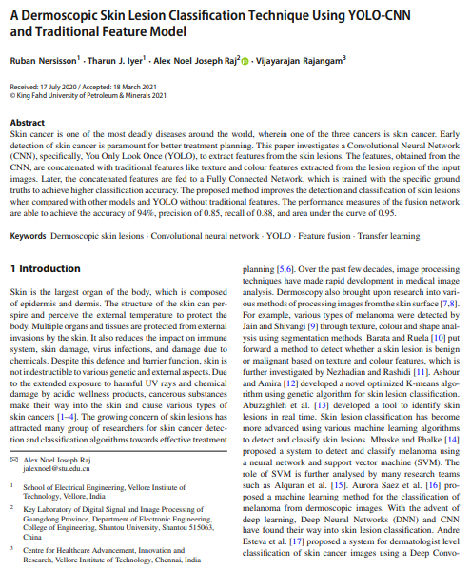
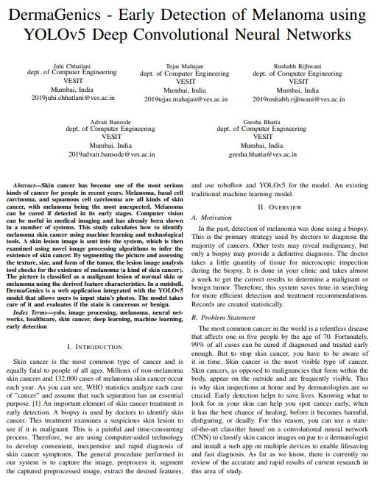
Why Skin Cancer?
Dari seluruh kasus kanker di Indonesia, kanker kulit menyumbang 7.8% kasus. Bahkan terdapat jenis kanker kulit yang mematikan, yaitu Melanoma yang menyumbang 75% kematian dari keseluruhan kasus kanker kulit.

Slide 3
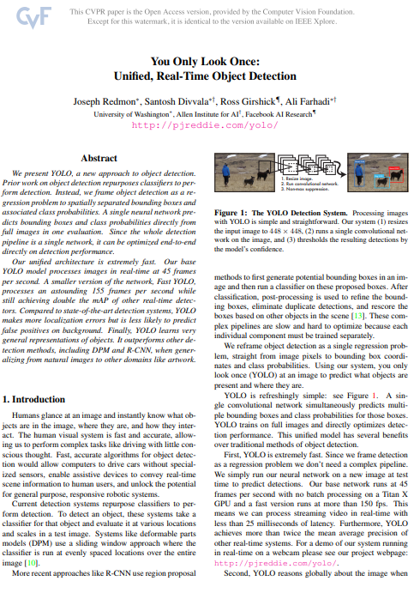
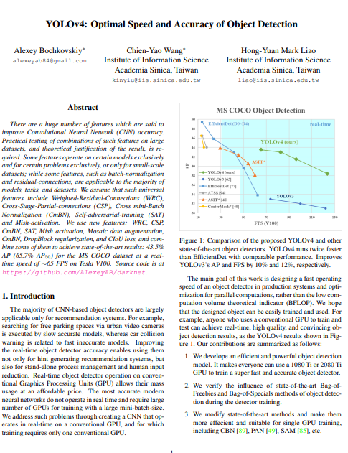
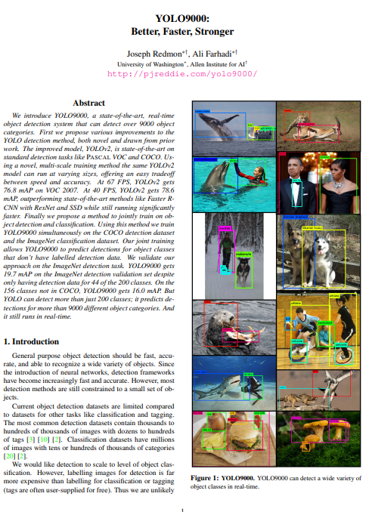
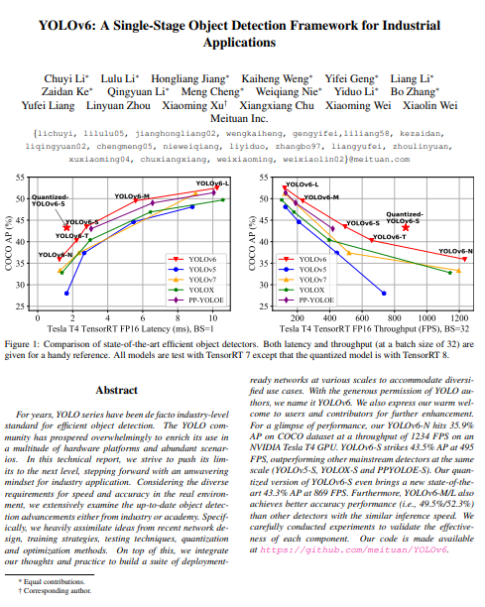
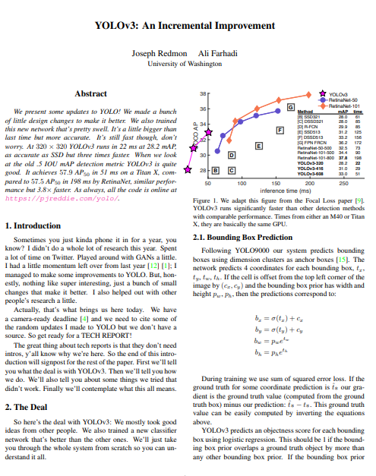
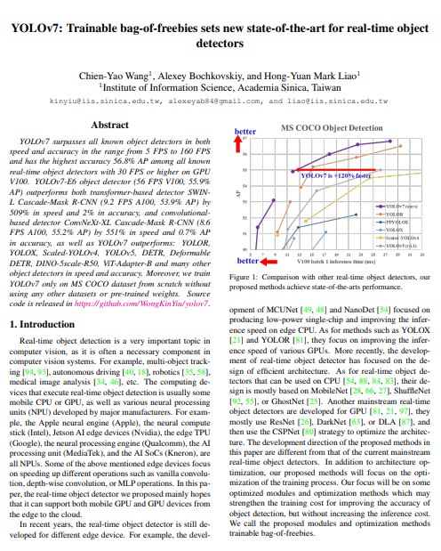
Why YOLO-v7?
Notes:
Karena YOLO termasuk one stage detector algorithm sehingga dapat memprediksi objek secara real-time. Hal ini juga mempertimbangkan lokasi kanker kulit yang terlihat oleh mata sehingga dapat dideteksi secara langsung. YOLO-v7 merupakan versi terbaru dari YOLO dengan berbagai modifikasi jaringannya yang membuat metode YOLO semakin optimal. Di sisi lain, terdapat banyak variasi dari metode YOLO oleh para penggemar CNN dan komunitas computer vision. Hal ini menunjukkan bahwa YOLO merupakan metode yang baik karena masih banyak dikembangkan oleh berbagai pihak. Meskipun hal ini juga banyak memunculkan versi YOLO yang tidak resmi dan menjadi bahan kontroversi.

Slide 4
Bagaimana YOLO melakukan prediksi?
Coordinates –Width Height – Confidence Score - Classification

Slide 5
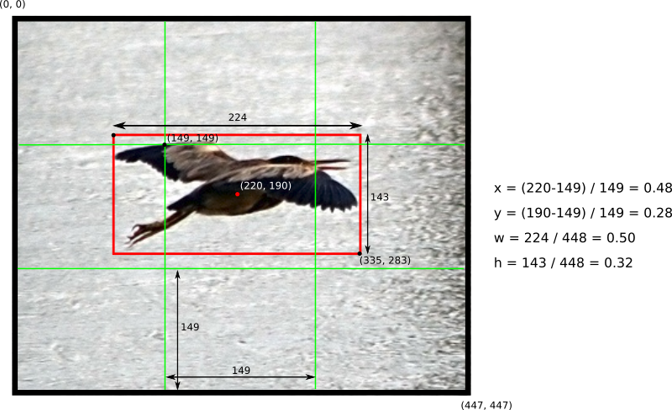
Notes:
Berikut adalah contoh bagaimana menentukan koordinat dan ukuran dari bounding box. YOLO membagi citra menjadi beberapa kisi. Setiap kisi ini memiliki tanggung jawab untuk memprediksi objek di dalamnya termasuk probabilitas kelas. Sehingga terdapat 5 komponen pada bounding box, yaitu (x, y, w, h, confidence). Nilai pada predictor vector dinormalisasi menggunakan metode Min-Max Scaler.
Jika tidak terdapat objek pada kisi sel, confidence score bernilai nol karena nilai tersebut berdasarkan perkalian antara probabilitas objek dan IoU.

Slide 6
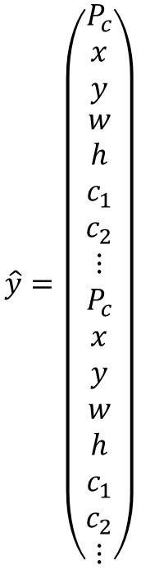
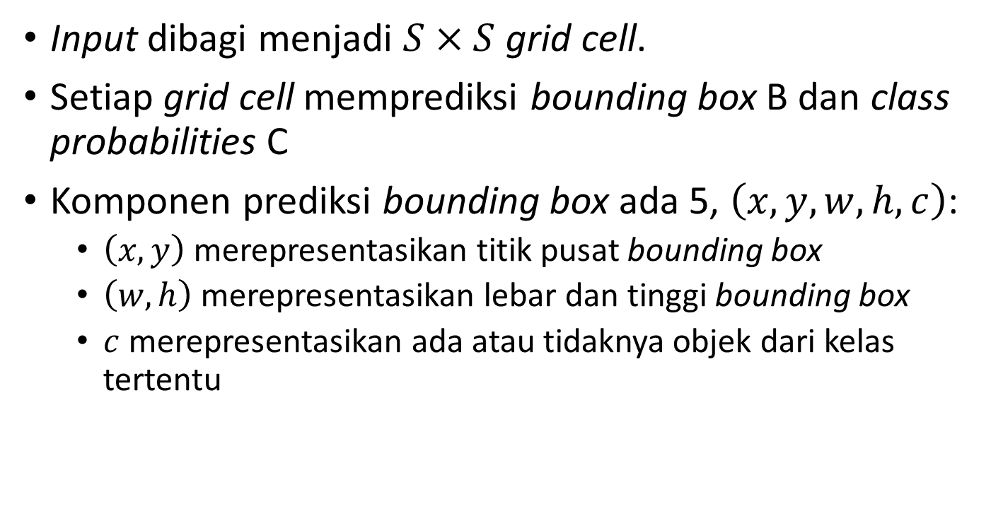
Bagaimana keluaran YOLO?
$$\hat{y}=\left(\begin{aligned}\begin{matrix}P_{c} \\ x \\ y\end{matrix} \\ w \\ h \\ c_{1} \\ c_{2} \\ ⋮ \\ P_{c} \\ x \\ y \\ w \\ h \\ c_{1} \\ c_{2} \\ ⋮\end{aligned}\right)$$
Input dibagi menjadi $S×S$ grid cell.
Setiap grid cell memprediksi bounding box B dan class probabilities C
Komponen prediksi bounding box ada 5, $\left(x,y,w,h,c\right)$:
$\left(x,y\right)$ merepresentasikan titik pusat bounding box
$\left(w,h\right)$ merepresentasikan lebar dan tinggi bounding box
$c$ merepresentasikan ada atau tidaknya objek dari kelas tertentu

Slide 7
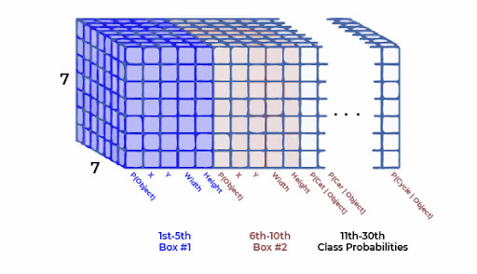

Slide 8
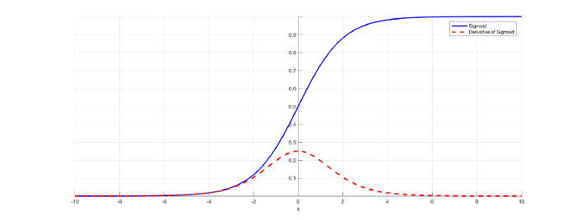
Vanishing Gradient

Slide 9
Components in YOLO-v7
Layer | In | Out | F | S | K | Layer | In | Out | F | S | K
Conv | 3 | 32 | 3 | 1 | 1 | Concat
Conv | 32 | 64 | 3 | 2 | 1 | Conv | 512 | 256 | 1 | 1 | 2
Conv | 64 | 64 | 3 | 1 | 1 | Conv | 256 | 128 | 3 | 1 | 1
Conv | 64 | 128 | 3 | 2 | 1 | Conv | 128 | 128 | 3 | 1 | 3
Conv | 128 | 64 | 1 | 1 | 2 | Concat
Conv | 64 | 64 | 3 | 1 | 4 | Conv | 1024 | 256 | 1 | 1 | 1
Concat |  |  |  |  |  | Conv | 256 | 128 | 1 | 1 | 1
Conv | 256 | 256 | 1 | 1 | 1 | Upsample
Max Pool |  |  |  |  |  | Conv | 512 | 128 | 1 | 1 | 1
Conv | 256 | 128 | 1 | 1 | 2 | Concat
Conv | 128 | 128 | 3 | 2 | 1 | Conv | 256 | 128 | 1 | 1 | 2
Concat |  |  |  |  |  | Conv | 128 | 64 | 3 | 1 | 1
Conv | 256 | 128 | 1 | 1 | 2 | Conv | 64 | 64 | 3 | 1 | 3
Conv | 128 | 128 | 3 | 1 | 4 | Concat
Concat |  |  |  |  |  | Conv | 512 | 128 | 1 | 1 | 1
Conv | 512 | 512 | 1 | 1 | 1 | Max Pool
Max Pool |  |  |  |  |  | Conv | 128 | 128 | 1 | 1 | 2
Conv | 512 | 256 | 1 | 1 | 2 | Conv | 128 | 128 | 3 | 2 | 1
Conv | 256 | 256 | 1 | 1 | 1 | Concat
Concat |  |  |  |  |  | Conv | 512 | 256 | 1 | 1 | 2
Conv | 512 | 256 | 1 | 1 | 2 | Conv | 256 | 128 | 3 | 1 | 1
Conv | 256 | 256 | 3 | 1 | 4 | Conv | 128 | 128 | 3 | 1 | 3
Concat |  |  |  |  |  | Concat
Conv | 1024 | 1024 | 1 | 1 | 1 | Conv | 1024 | 256 | 1 | 1 | 1
Max Pool |  |  |  |  |  | Max Pool
Conv | 1024 | 512 | 1 | 1 | 2 | Conv | 256 | 256 | 1 | 1 | 2
Conv | 512 | 512 | 3 | 2 | 1 | Conv | 256 | 256 | 3 | 2 | 1
Concat |  |  |  |  |  | Concat
Conv | 1024 | 256 | 1 | 1 | 2 | Conv | 1024 | 512 | 1 | 1 | 2
Conv | 256 | 256 | 3 | 1 | 4 | Conv | 512 | 256 | 3 | 1 | 1
Concat |  |  |  |  |  | Conv | 256 | 256 | 3 | 1 | 3
Conv | 1024 | 1024 | 1 | 1 | 1 | Concat
SPP CSP C | 1024 | 512 |  |  |  | Conv | 2048 | 512 | 1 | 1 | 1
Conv | 512 | 256 | 1 | 1 | 1 | Rep Conv | 128 | 256 | 3 | 1
Upsample |  |  |  |  |  | Rep Conv | 256 | 512 | 3 | 1
Conv | 1024 | 256 | 1 | 1 | 1 | Rep Conv | 512 | 1024 | 3 | 1
Concat |  |  |  |  |  | IDetect
Convolutional Layer
Pooling Layer
Upsample Layer
Fully Connected Layer
Batch Normalization
Leaky ReLU
SiLU

Slide 10
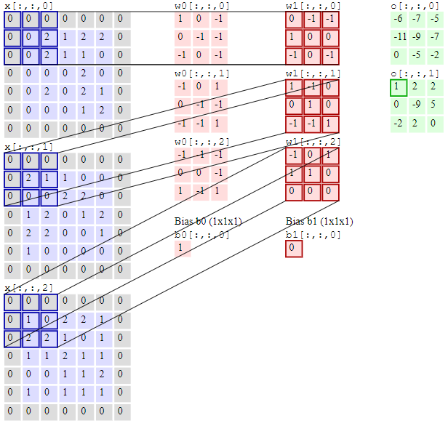
Convolutional Layer
Convolutional Layer melakukan operasi dot product antara dua matriks, yaitu matriks input (3-channel) dan matriks kernel. Kernel berjalan dari kiri-atas ke kanan-bawah untuk melakukan operasi dot product karena ukuran kernel lebih kecil dari matriks input. Hasil operasi tersebut biasa disebut activation map. Ukuran geser kernel biasa disebut stride.

Slide 11
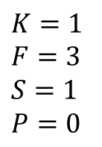
Convolutional Layer
RED
190 | 189 | 194 | 191 | 201 | 196 | 178 | 190 | 196 | 190
196 | 185 | 199 | 178 | 143 | 159 | 183 | 181 | 178 | 192
200 | 164 | 150 | 117 | 88 | 107 | 113 | 92 | 139 | 183
177 | 120 | 57 | 28 | 52 | 71 | 56 | 59 | 65 | 139
179 | 108 | 53 | 41 | 55 | 43 | 21 | 39 | 42 | 123
144 | 57 | 39 | 56 | 49 | 45 | 49 | 60 | 106 | 168
176 | 100 | 73 | 72 | 64 | 78 | 95 | 103 | 166 | 192
201 | 193 | 183 | 171 | 183 | 191 | 183 | 195 | 195 | 193
204 | 207 | 212 | 213 | 212 | 208 | 207 | 206 | 203 | 201
206 | 211 | 214 | 216 | 213 | 211 | 210 | 210 | 209 | 209
ACTIVATION MAP
-2 | 224 | 141 | -93 | 63 | 248 | 179 | 61
28 | 152 | 41 | -151 | -9 | -4 | -238 | 23
-128 | -325 | -389 | -134 | 33 | -97 | -95 | -296
38 | -82 | -61 | 55 | -54 | -254 | -146 | -423
-416 | -248 | 2 | -62 | -94 | -92 | -141 | -45
-266 | -287 | -242 | -333 | -235 | -144 | -225 | 116
188 | 223 | 156 | 255 | 298 | 181 | 202 | 101
32 | 88 | 100 | 90 | 54 | 42 | 36 | 6
KERNEL
-1 | -1 | -1
-1 | 8 | -1
-1 | -1 | -1
$K=1$
$F=3$
$S=1$
$P=0$

Slide 12
Convolutional Layer
RED
190 | 189 | 194 | 191 | 201 | 196 | 178 | 190 | 196 | 190
196 | 185 | 199 | 178 | 143 | 159 | 183 | 181 | 178 | 192
200 | 164 | 150 | 117 | 88 | 107 | 113 | 92 | 139 | 183
177 | 120 | 57 | 28 | 52 | 71 | 56 | 59 | 65 | 139
179 | 108 | 53 | 41 | 55 | 43 | 21 | 39 | 42 | 123
144 | 57 | 39 | 56 | 49 | 45 | 49 | 60 | 106 | 168
176 | 100 | 73 | 72 | 64 | 78 | 95 | 103 | 166 | 192
201 | 193 | 183 | 171 | 183 | 191 | 183 | 195 | 195 | 193
204 | 207 | 212 | 213 | 212 | 208 | 207 | 206 | 203 | 201
206 | 211 | 214 | 216 | 213 | 211 | 210 | 210 | 209 | 209
ACTIVATION MAP
-2 | 224 | 141 | -93 | 63 | 248 | 179 | 61
28 | 152 | 41 | -151 | -9 | -4 | -238 | 23
-128 | -325 | -389 | -134 | 33 | -97 | -95 | -296
38 | -82 | -61 | 55 | -54 | -254 | -146 | -423
-416 | -248 | 2 | -62 | -94 | -92 | -141 | -45
-266 | -287 | -242 | -333 | -235 | -144 | -225 | 116
188 | 223 | 156 | 255 | 298 | 181 | 202 | 101
32 | 88 | 100 | 90 | 54 | 42 | 36 | 6
KERNEL
-1 | -1 | -1
-1 | 8 | -1
-1 | -1 | -1
$K=1$
$F=3$
$S=1$
$P=0$

Slide 13
Convolutional Layer
RED
190 | 189 | 194 | 191 | 201 | 196 | 178 | 190 | 196 | 190
196 | 185 | 199 | 178 | 143 | 159 | 183 | 181 | 178 | 192
200 | 164 | 150 | 117 | 88 | 107 | 113 | 92 | 139 | 183
177 | 120 | 57 | 28 | 52 | 71 | 56 | 59 | 65 | 139
179 | 108 | 53 | 41 | 55 | 43 | 21 | 39 | 42 | 123
144 | 57 | 39 | 56 | 49 | 45 | 49 | 60 | 106 | 168
176 | 100 | 73 | 72 | 64 | 78 | 95 | 103 | 166 | 192
201 | 193 | 183 | 171 | 183 | 191 | 183 | 195 | 195 | 193
204 | 207 | 212 | 213 | 212 | 208 | 207 | 206 | 203 | 201
206 | 211 | 214 | 216 | 213 | 211 | 210 | 210 | 209 | 209
ACTIVATION MAP
-2 | 224 | 141 | -93 | 63 | 248 | 179 | 61
28 | 152 | 41 | -151 | -9 | -4 | -238 | 23
-128 | -325 | -389 | -134 | 33 | -97 | -95 | -296
38 | -82 | -61 | 55 | -54 | -254 | -146 | -423
-416 | -248 | 2 | -62 | -94 | -92 | -141 | -45
-266 | -287 | -242 | -333 | -235 | -144 | -225 | 116
188 | 223 | 156 | 255 | 298 | 181 | 202 | 101
32 | 88 | 100 | 90 | 54 | 42 | 36 | 6
KERNEL
-1 | -1 | -1
-1 | 8 | -1
-1 | -1 | -1
$K=1$
$F=3$
$S=1$
$P=0$

Slide 14
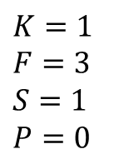
Convolutional Layer
RED – GREEN - BLUE
192 | 193 | 196 | 197 | 207 | 204 | 186 | 197 | 203 | 196
201 | 189 | 205 | 184 | 152 | 169 | 193 | 191 | 187 | 201
208 | 173 | 160 | 129 | 102 | 122 | 129 | 106 | 152 | 196
187 | 131 | 70 | 43 | 69 | 88 | 75 | 77 | 81 | 153
192 | 123 | 68 | 56 | 72 | 61 | 41 | 60 | 61 | 141
155 | 70 | 52 | 71 | 66 | 62 | 68 | 79 | 123 | 184
185 | 109 | 82 | 81 | 75 | 91 | 110 | 118 | 181 | 205
202 | 194 | 184 | 174 | 188 | 197 | 189 | 203 | 201 | 201
196 | 201 | 206 | 208 | 207 | 205 | 204 | 205 | 200 | 200
193 | 198 | 203 | 205 | 205 | 203 | 203 | 203 | 202 | 202
ACTIVATION MAP
-2 | 224 | 141 | -93 | 63 | 248 | 179 | 61
28 | 152 | 41 | -151 | -9 | -4 | -238 | 23
-128 | -325 | -389 | -134 | 33 | -97 | -95 | -296
38 | -82 | -61 | 55 | -54 | -254 | -146 | -423
-416 | -248 | 2 | -62 | -94 | -92 | -141 | -45
-266 | -287 | -242 | -333 | -235 | -144 | -225 | 116
188 | 223 | 156 | 255 | 298 | 181 | 202 | 101
32 | 88 | 100 | 90 | 54 | 42 | 36 | 6
159 | 160 | 166 | 167 | 179 | 177 | 162 | 174 | 180 | 175
166 | 156 | 172 | 154 | 123 | 142 | 166 | 167 | 165 | 179
172 | 139 | 126 | 96 | 69 | 91 | 98 | 78 | 126 | 170
151 | 96 | 35 | 8 | 35 | 56 | 43 | 47 | 50 | 125
154 | 85 | 30 | 21 | 38 | 27 | 7 | 28 | 29 | 111
120 | 35 | 17 | 36 | 32 | 30 | 36 | 47 | 91 | 153
151 | 75 | 48 | 49 | 43 | 60 | 79 | 87 | 150 | 177
173 | 165 | 155 | 146 | 160 | 169 | 161 | 176 | 173 | 174
172 | 178 | 183 | 185 | 184 | 182 | 181 | 183 | 177 | 178
174 | 179 | 184 | 186 | 185 | 183 | 183 | 183 | 182 | 182
190 | 189 | 194 | 191 | 201 | 196 | 178 | 190 | 196 | 190
196 | 185 | 199 | 178 | 143 | 159 | 183 | 181 | 178 | 192
200 | 164 | 150 | 117 | 88 | 107 | 113 | 92 | 139 | 183
177 | 120 | 57 | 28 | 52 | 71 | 56 | 59 | 65 | 139
179 | 108 | 53 | 41 | 55 | 43 | 21 | 39 | 42 | 123
144 | 57 | 39 | 56 | 49 | 45 | 49 | 60 | 106 | 168
176 | 100 | 73 | 72 | 64 | 78 | 95 | 103 | 166 | 192
201 | 193 | 183 | 171 | 183 | 191 | 183 | 195 | 195 | 193
204 | 207 | 212 | 213 | 212 | 208 | 207 | 206 | 203 | 201
206 | 211 | 214 | 216 | 213 | 211 | 210 | 210 | 209 | 209
-12 | 212 | 134 | -91 | 71 | 239 | 187 | 71
38 | 152 | 46 | -153 | -4 | -6 | -238 | 27
-124 | -321 | -386 | -126 | 40 | -88 | -83 | -314
42 | -93 | -63 | 59 | -61 | -258 | -126 | -420
-400 | -243 | 10 | -48 | -82 | -77 | -131 | -54
-264 | -294 | -245 | -338 | -230 | -134 | -217 | 122
185 | 211 | 161 | 262 | 302 | 171 | 217 | 82
39 | 86 | 97 | 76 | 50 | 28 | 48 | -15
KERNEL
-1 | -1 | -1
-1 | 8 | -1
-1 | -1 | -1
-16 | 219 | 124 | -98 | 57 | 240 | 175 | 54
33 | 156 | 47 | -140 | -1 | 11 | -237 | 24
-133 | -323 | -382 | -121 | 33 | -84 | -89 | -298
59 | -72 | -63 | 60 | -53 | -242 | -125 | -410
-406 | -244 | 16 | -41 | -88 | -78 | -130 | -45
-252 | -279 | -244 | -330 | -227 | -127 | -210 | 134
187 | 217 | 161 | 266 | 307 | 179 | 216 | 95
32 | 81 | 92 | 71 | 44 | 24 | 35 | -17
$K=1$
$F=3$
$S=1$
$P=0$

Slide 15
Convolutional Layer
RED – GREEN - BLUE
192 | 193 | 196 | 197 | 207 | 204 | 186 | 197 | 203 | 196
201 | 189 | 205 | 184 | 152 | 169 | 193 | 191 | 187 | 201
208 | 173 | 160 | 129 | 102 | 122 | 129 | 106 | 152 | 196
187 | 131 | 70 | 43 | 69 | 88 | 75 | 77 | 81 | 153
192 | 123 | 68 | 56 | 72 | 61 | 41 | 60 | 61 | 141
155 | 70 | 52 | 71 | 66 | 62 | 68 | 79 | 123 | 184
185 | 109 | 82 | 81 | 75 | 91 | 110 | 118 | 181 | 205
202 | 194 | 184 | 174 | 188 | 197 | 189 | 203 | 201 | 201
196 | 201 | 206 | 208 | 207 | 205 | 204 | 205 | 200 | 200
193 | 198 | 203 | 205 | 205 | 203 | 203 | 203 | 202 | 202
FINAL ACTIVATION MAP
-30 | 655 | 399 | -282 | 191 | 727 | 541 | 186
99 | 460 | 134 | -444 | -14 | 1 | -713 | 74
-385 | -969 | -1157 | -381 | 106 | -269 | -267 | -908
139 | -247 | -187 | 174 | -168 | -754 | -397 | -1253
-1222 | -735 | 28 | -151 | -264 | -247 | -402 | -144
-782 | -860 | -731 | -1001 | -692 | -405 | -652 | 372
560 | 651 | 478 | 783 | 907 | 531 | 635 | 278
103 | 255 | 289 | 237 | 148 | 94 | 119 | -26
159 | 160 | 166 | 167 | 179 | 177 | 162 | 174 | 180 | 175
166 | 156 | 172 | 154 | 123 | 142 | 166 | 167 | 165 | 179
172 | 139 | 126 | 96 | 69 | 91 | 98 | 78 | 126 | 170
151 | 96 | 35 | 8 | 35 | 56 | 43 | 47 | 50 | 125
154 | 85 | 30 | 21 | 38 | 27 | 7 | 28 | 29 | 111
120 | 35 | 17 | 36 | 32 | 30 | 36 | 47 | 91 | 153
151 | 75 | 48 | 49 | 43 | 60 | 79 | 87 | 150 | 177
173 | 165 | 155 | 146 | 160 | 169 | 161 | 176 | 173 | 174
172 | 178 | 183 | 185 | 184 | 182 | 181 | 183 | 177 | 178
174 | 179 | 184 | 186 | 185 | 183 | 183 | 183 | 182 | 182
190 | 189 | 194 | 191 | 201 | 196 | 178 | 190 | 196 | 190
196 | 185 | 199 | 178 | 143 | 159 | 183 | 181 | 178 | 192
200 | 164 | 150 | 117 | 88 | 107 | 113 | 92 | 139 | 183
177 | 120 | 57 | 28 | 52 | 71 | 56 | 59 | 65 | 139
179 | 108 | 53 | 41 | 55 | 43 | 21 | 39 | 42 | 123
144 | 57 | 39 | 56 | 49 | 45 | 49 | 60 | 106 | 168
176 | 100 | 73 | 72 | 64 | 78 | 95 | 103 | 166 | 192
201 | 193 | 183 | 171 | 183 | 191 | 183 | 195 | 195 | 193
204 | 207 | 212 | 213 | 212 | 208 | 207 | 206 | 203 | 201
206 | 211 | 214 | 216 | 213 | 211 | 210 | 210 | 209 | 209
KERNEL
-1 | -1 | -1
-1 | 8 | -1
-1 | -1 | -1
$K=1$
$F=3$
$S=1$
$P=0$

Slide 16
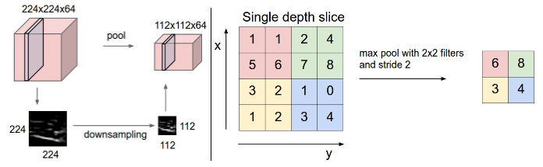
Pooling Layer
Pooling Layer membantu untuk mengurangi ukuran spasial dari activation map sehingga dapat mengurangi waktu komputasi dan jumlah bobot serta mengontrol overfitting.

Slide 17
Pooling Layer
ACTIVATION MAP
-30 | 655 | 399 | -282 | 191 | 727 | 541 | 186
99 | 460 | 134 | -444 | -14 | 1 | -713 | 74
-385 | -969 | -1157 | -381 | 106 | -269 | -267 | -908
139 | -247 | -187 | 174 | -168 | -754 | -397 | -1253
-1222 | -735 | 28 | -151 | -264 | -247 | -402 | -144
-782 | -860 | -731 | -1001 | -692 | -405 | -652 | 372
560 | 651 | 478 | 783 | 907 | 531 | 635 | 278
103 | 255 | 289 | 237 | 148 | 94 | 119 | -26
POOLED LAYER
655 | 399 | 727 | 541
139 | 174 | 106 | -267
-735 | 28 | -247 | 372
651 | 783 | 907 | 635

Slide 18
Pooling Layer
ACTIVATION MAP
-30 | 655 | 399 | -282 | 191 | 727 | 541 | 186
99 | 460 | 134 | -444 | -14 | 1 | -713 | 74
-385 | -969 | -1157 | -381 | 106 | -269 | -267 | -908
139 | -247 | -187 | 174 | -168 | -754 | -397 | -1253
-1222 | -735 | 28 | -151 | -264 | -247 | -402 | -144
-782 | -860 | -731 | -1001 | -692 | -405 | -652 | 372
560 | 651 | 478 | 783 | 907 | 531 | 635 | 278
103 | 255 | 289 | 237 | 148 | 94 | 119 | -26
POOLED LAYER
655 | 399 | 727 | 541
139 | 174 | 106 | -267
-735 | 28 | -247 | 372
651 | 783 | 907 | 635

Slide 19
Pooling Layer
ACTIVATION MAP
-30 | 655 | 399 | -282 | 191 | 727 | 541 | 186
99 | 460 | 134 | -444 | -14 | 1 | -713 | 74
-385 | -969 | -1157 | -381 | 106 | -269 | -267 | -908
139 | -247 | -187 | 174 | -168 | -754 | -397 | -1253
-1222 | -735 | 28 | -151 | -264 | -247 | -402 | -144
-782 | -860 | -731 | -1001 | -692 | -405 | -652 | 372
560 | 651 | 478 | 783 | 907 | 531 | 635 | 278
103 | 255 | 289 | 237 | 148 | 94 | 119 | -26
POOLED LAYER
655 | 399 | 727 | 541
139 | 174 | 106 | -267
-735 | 28 | -247 | 372
651 | 783 | 907 | 635

Slide 20
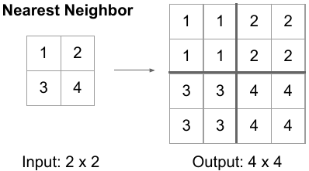
Upsample Layer

Slide 21
Upsample Layer
UPSAMPLED LAYER |  |  |  | UPSAMPLED LAYER
655 | 655 | 399 | 399 | 727 | 727 | 541 | 541
655 | 655 | 399 | 399 | 727 | 727 | 541 | 541
139 | 139 | 174 | 174 | 106 | 106 | -267 | -267
139 | 139 | 174 | 174 | 106 | 106 | -267 | -267
-735 | -735 | 28 | 28 | -247 | -247 | 372 | 372
-735 | -735 | 28 | 28 | -247 | -247 | 372 | 372
651 | 651 | 783 | 783 | 907 | 907 | 635 | 635
651 | 651 | 783 | 783 | 907 | 907 | 635 | 635
POOLED LAYER
655 | 399 | 727 | 541
139 | 174 | 106 | -267
-735 | 28 | -247 | 372
651 | 783 | 907 | 635

Slide 22
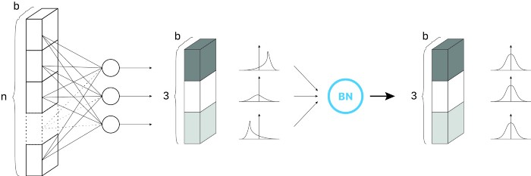


Batch Normalization

Slide 23
Batch Normalization
UPSAMPLED LAYER |  |  |  | UPSAMPLED LAYER
655 | 655 | 399 | 399 | 727 | 727 | 541 | 541
655 | 655 | 399 | 399 | 727 | 727 | 541 | 541
139 | 139 | 174 | 174 | 106 | 106 | -267 | -267
139 | 139 | 174 | 174 | 106 | 106 | -267 | -267
-735 | -735 | 28 | 28 | -247 | -247 | 372 | 372
-735 | -735 | 28 | 28 | -247 | -247 | 372 | 372
651 | 651 | 783 | 783 | 907 | 907 | 635 | 635
651 | 651 | 783 | 783 | 907 | 907 | 635 | 635
BATCH NORMALIZED
0.0018 | 0.0018 | 0.0005 | 0.0005 | 0.0022 | 0.0022 | 0.0012 | 0.0012
0.0018 | 0.0018 | 0.0005 | 0.0005 | 0.0022 | 0.0022 | 0.0012 | 0.0012
-0.0009 | -0.0009 | -0.0007 | -0.0007 | -0.001 | -0.001 | -0.003 | -0.003
-0.0009 | -0.0009 | -0.0007 | -0.0007 | -0.001 | -0.001 | -0.003 | -0.003
-0.0054 | -0.0054 | -0.0014 | -0.0014 | -0.0029 | -0.0029 | 0.0004 | 0.0004
-0.0054 | -0.0054 | -0.0014 | -0.0014 | -0.0029 | -0.0029 | 0.0004 | 0.0004
0.0018 | 0.0018 | 0.0025 | 0.0025 | 0.0031 | 0.0031 | 0.0017 | 0.0017
0.0018 | 0.0018 | 0.0025 | 0.0025 | 0.0031 | 0.0031 | 0.0017 | 0.0017

Slide 24
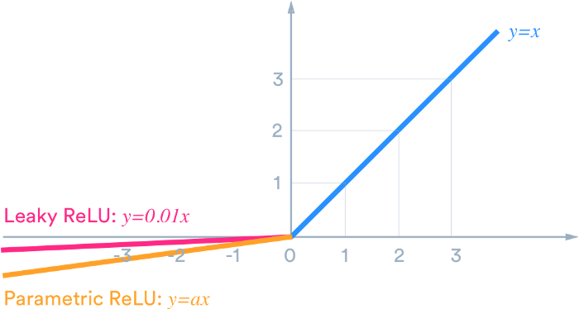

Leaky ReLU
$$y=\max\left(0.01x, x\right)$$

Slide 25
Leaky ReLU
ACTIVATED LEAKY RELU
0.0018320 | 0.0018320 | 0.0004951 | 0.0004951 | 0.0022081 | 0.0022081 | 0.0012367 | 0.0012367
0.0018320 | 0.0018320 | 0.0004951 | 0.0004951 | 0.0022081 | 0.0022081 | 0.0012367 | 0.0012367
-0.0000086 | -0.0000086 | -0.0000068 | -0.0000068 | -0.0000104 | -0.0000104 | -0.0000298 | -0.0000298
-0.0000086 | -0.0000086 | -0.0000068 | -0.0000068 | -0.0000104 | -0.0000104 | -0.0000298 | -0.0000298
-0.0000543 | -0.0000543 | -0.0000144 | -0.0000144 | -0.0000288 | -0.0000288 | 0.0003541 | 0.0003541
-0.0000543 | -0.0000543 | -0.0000144 | -0.0000144 | -0.0000288 | -0.0000288 | 0.0003541 | 0.0003541
0.0018112 | 0.0018112 | 0.0025005 | 0.0025005 | 0.0031481 | 0.0031481 | 0.0017276 | 0.0017276
0.0018112 | 0.0018112 | 0.0025005 | 0.0025005 | 0.0031481 | 0.0031481 | 0.0017276 | 0.0017276
BATCH NORMALIZED
0.0018 | 0.0018 | 0.0005 | 0.0005 | 0.0022 | 0.0022 | 0.0012 | 0.0012
0.0018 | 0.0018 | 0.0005 | 0.0005 | 0.0022 | 0.0022 | 0.0012 | 0.0012
-0.0009 | -0.0009 | -0.0007 | -0.0007 | -0.001 | -0.001 | -0.003 | -0.003
-0.0009 | -0.0009 | -0.0007 | -0.0007 | -0.001 | -0.001 | -0.003 | -0.003
-0.0054 | -0.0054 | -0.0014 | -0.0014 | -0.0029 | -0.0029 | 0.0004 | 0.0004
-0.0054 | -0.0054 | -0.0014 | -0.0014 | -0.0029 | -0.0029 | 0.0004 | 0.0004
0.0018 | 0.0018 | 0.0025 | 0.0025 | 0.0031 | 0.0031 | 0.0017 | 0.0017
0.0018 | 0.0018 | 0.0025 | 0.0025 | 0.0031 | 0.0031 | 0.0017 | 0.0017

Slide 26
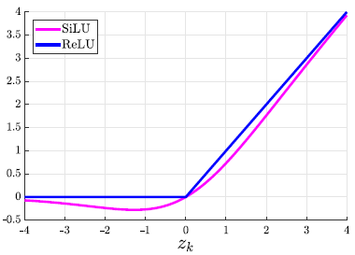
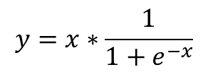
SiLU
$$y=x∗\frac{1}{1+e^{−x}}$$

Slide 27
SiLU
ACTIVATED SiLU
0.00091686 | 0.00091686 | 0.000247597 | 0.000247597 | 0.001105251 | 0.001105251 | 0.000618719 | 0.000618719
0.00091686 | 0.00091686 | 0.000247597 | 0.000247597 | 0.001105251 | 0.001105251 | 0.000618719 | 0.000618719
-0.000431211 | -0.000431211 | -0.000339886 | -0.000339886 | -0.000517302 | -0.000517302 | -0.001489358 | -0.001489358
-0.000431211 | -0.000431211 | -0.000339886 | -0.000339886 | -0.000517302 | -0.000517302 | -0.001489358 | -0.001489358
-0.002706313 | -0.002706313 | -0.00072073 | -0.00072073 | -0.001437285 | -0.001437285 | 0.000177063 | 0.000177063
-0.002706313 | -0.002706313 | -0.00072073 | -0.00072073 | -0.001437285 | -0.001437285 | 0.000177063 | 0.000177063
0.000906396 | 0.000906396 | 0.001251826 | 0.001251826 | 0.001576536 | 0.001576536 | 0.000864542 | 0.000864542
0.000906396 | 0.000906396 | 0.001251826 | 0.001251826 | 0.001576536 | 0.001576536 | 0.000864542 | 0.000864542
BATCH NORMALIZED
0.0018 | 0.0018 | 0.0005 | 0.0005 | 0.0022 | 0.0022 | 0.0012 | 0.0012
0.0018 | 0.0018 | 0.0005 | 0.0005 | 0.0022 | 0.0022 | 0.0012 | 0.0012
-0.0009 | -0.0009 | -0.0007 | -0.0007 | -0.001 | -0.001 | -0.003 | -0.003
-0.0009 | -0.0009 | -0.0007 | -0.0007 | -0.001 | -0.001 | -0.003 | -0.003
-0.0054 | -0.0054 | -0.0014 | -0.0014 | -0.0029 | -0.0029 | 0.0004 | 0.0004
-0.0054 | -0.0054 | -0.0014 | -0.0014 | -0.0029 | -0.0029 | 0.0004 | 0.0004
0.0018 | 0.0018 | 0.0025 | 0.0025 | 0.0031 | 0.0031 | 0.0017 | 0.0017
0.0018 | 0.0018 | 0.0025 | 0.0025 | 0.0031 | 0.0031 | 0.0017 | 0.0017

Slide 28
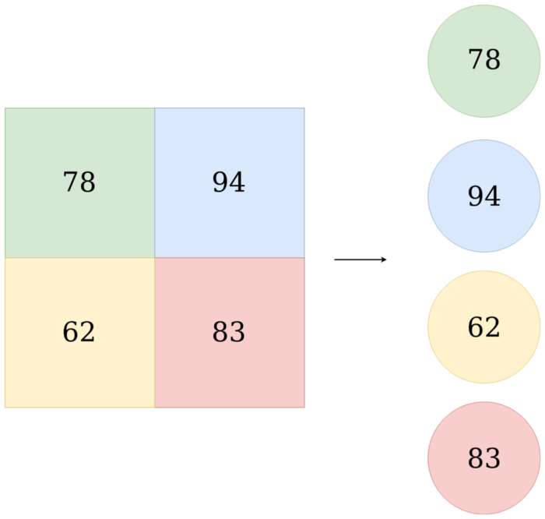
Fully Connected Layer

Slide 29





Coordinates
Confidence Score
Width Height
Classification

Slide 30
Batch Normalization

Slide 31
Leaky ReLU

Slide 32
SiLU

